Slide 1
What impacts CAASP test scores in CA school districts?
Analysis of multiple factors including school type, teacher experience, socioeconomic advantage

Slide 2
Team Members
Warren Judson
Rabia Sungur
Kelly McClendon
Sunny Singh

Slide 3
Project Overview
For this project, the team is using the California Department of Education Data Base. Our question is What impacts CAASP test scores in Ca School districts.

Slide 4
Does the school type impact test scores – Magnet schools vs Public Schools
Here in Placer Co., we have 2 Magnet labeled High schools. Magnet high schools are public high schools that offer specialized courses, often designed around a theme. Any student in the designated region can attend, which causes most magnet schools to use a lottery system to accept applicants. Some magnet schools use an application process that involves test scores and GPAs.
I decided to see if the two most populated non-magnet High Schools tested higher that the two Magnet labeled High Schools.
Based on the data analyzed for Placer County, it appears that the magnet schools have higher test scores than the public schools do.

Slide 5
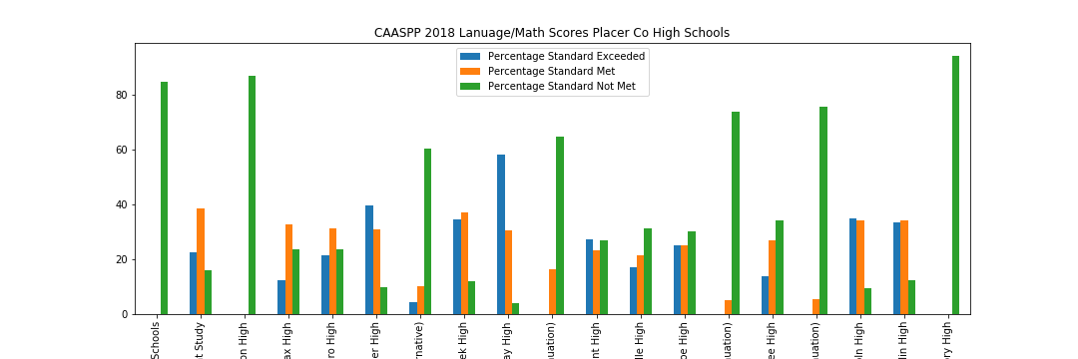
Placer County CAASP Test Scores for Magnet and Public schools

Slide 6
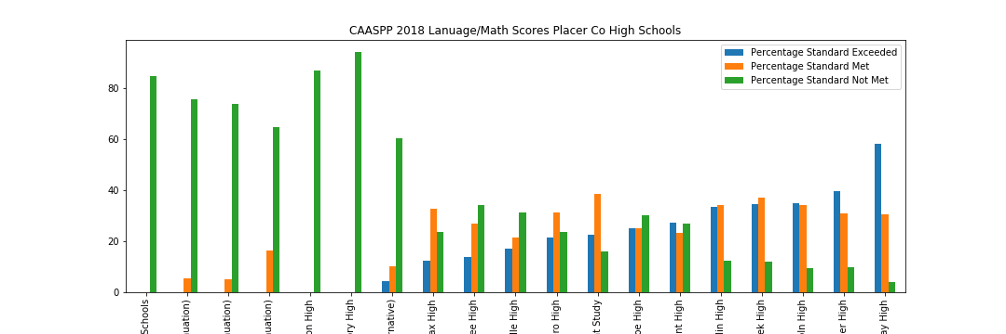
Placer County CAASP Test Scores for Magnet and Public schools

Slide 7
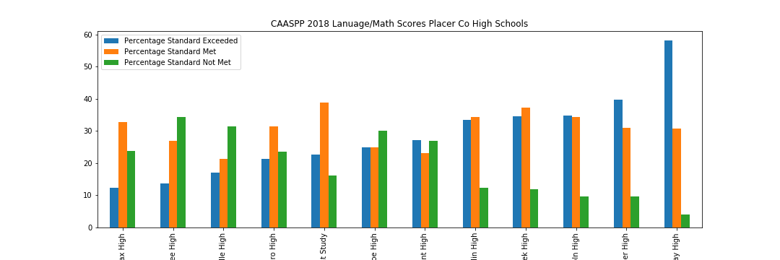
2018 Placer County High School CAASP Test Scores (excluding Adult Ed and Continuation)

Slide 8
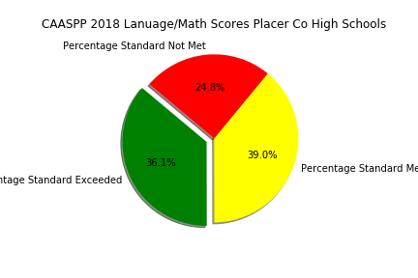
2018 Placer County High School Test Scores

Slide 9
Success Levels of Placer County High Schools and Magnet School Effect on Test Scores
Firstly, I filtered my public schools data from department of education just for high schools to see how many public schools in each county in California. As seen on the graph Los Angeles has the most number of high schools and the least is Sierra County. With Warren we decided to choose one County and worked on Placer County. I merged the California Assessment of Student Performance and Progress Test Result data of last four years with my high school data and get the Success of Placer County High Schools Comparison based on both English art and literacy and Math test scores.

Slide 10
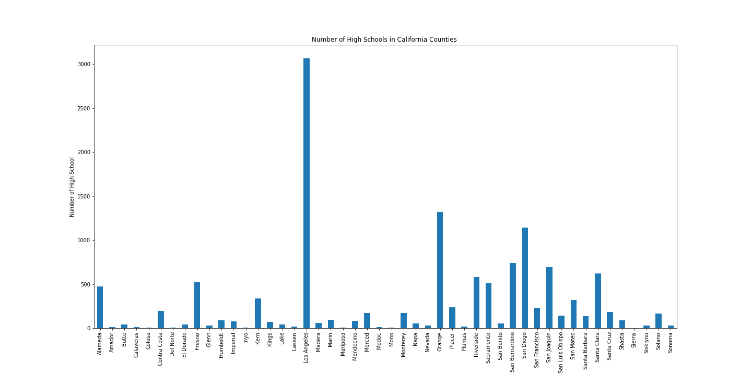
Number of High Schools in CA counties

Slide 11
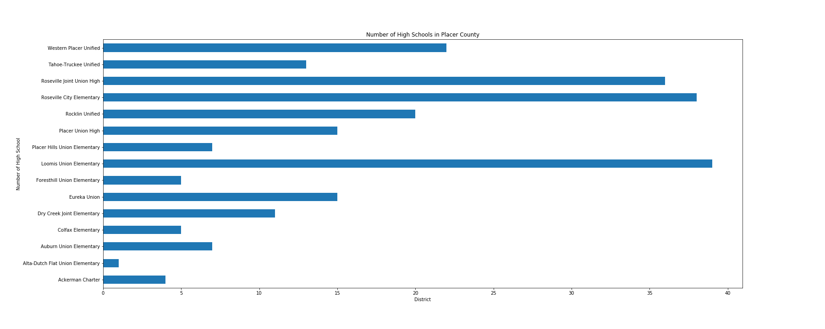
Number of High Schools in Placer County

Slide 12
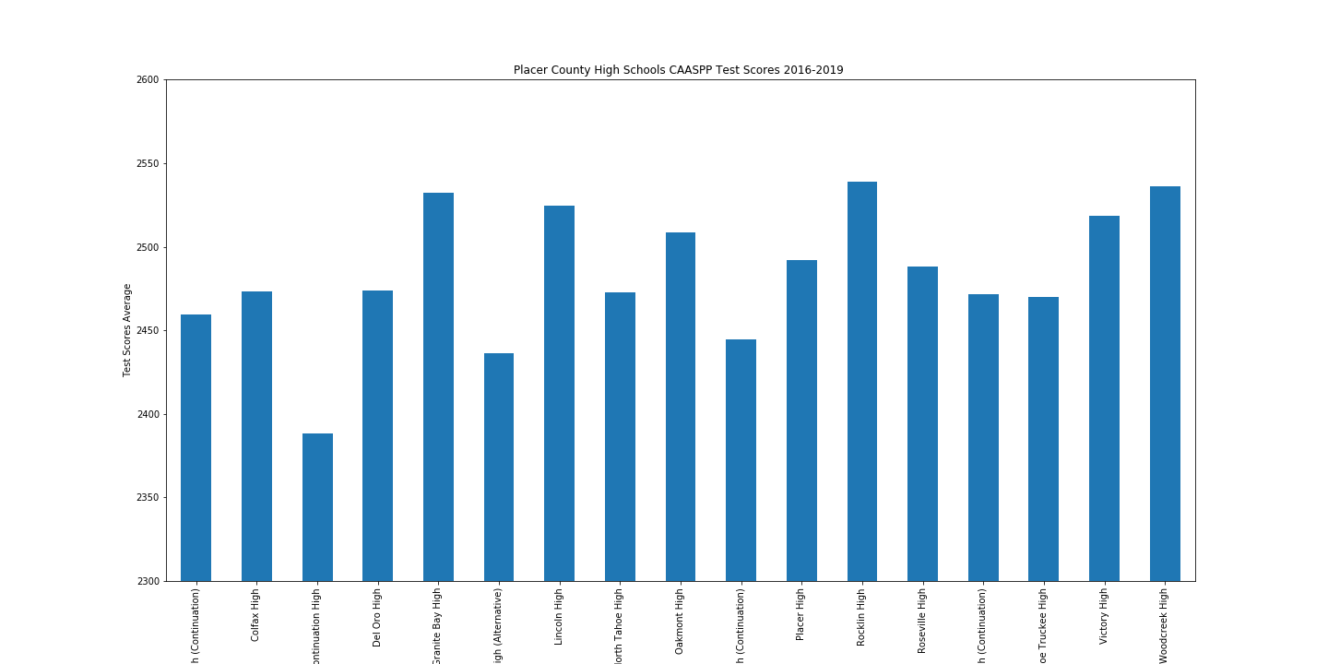
Placer County High School CAASP Test Scores 2016-2019

Slide 13
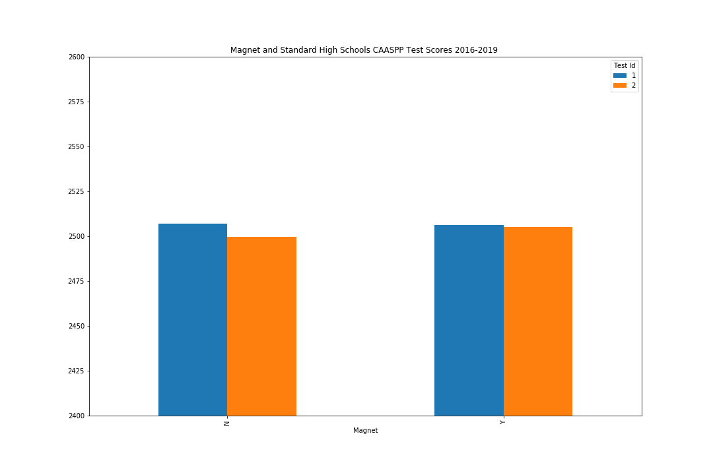
2016 – 2019 CAASP Test Scores for Magnet and Public High Schools

Slide 14
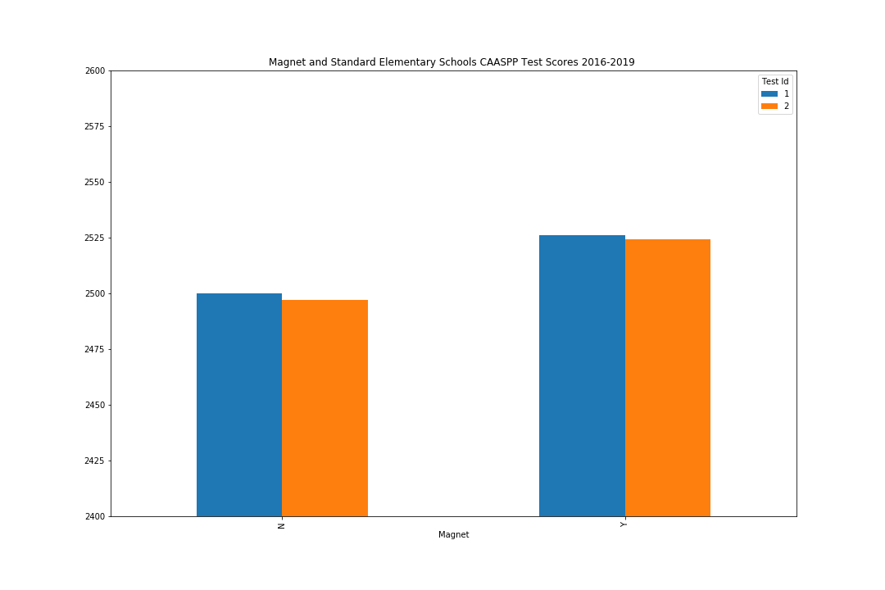
2016 – 2019 CAASP Test Scores for Magnet and Public Elementary Schools

Slide 15
Does Teacher Experience Impact Test Scores?
Within the CAASP Test score subgroups (Standard Met and Above, Standard Nearly Met, and Standard Not Met), do test scores improve with more experienced teachers?
When compared across school districts in CA, there does not seem to be a correlation between higher test scores and more experienced teachers.

Slide 16
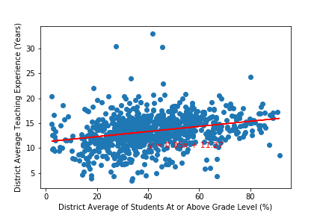
District Average Standard Met and Above Test Scores vs Teacher Experience

Slide 17
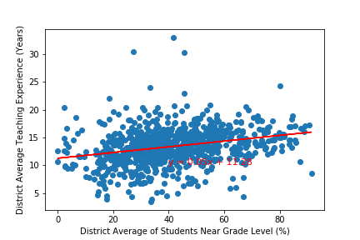
District Average Near Passing Test Scores vs Teacher Experience

Slide 18
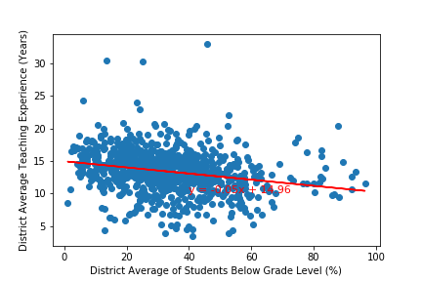
District Average Standard Not Met Test Scores vs Teacher Experience

Slide 19
Impacts from other factors on CAASP Test scores
Funding type vs Test Scores
Economic advantage vs Test Scores
State funded schools had higher test scores compared to locally funded schools. Elementary school students seems to have the best education level system in California in 2018.
Economically advantaged students definitely had the upper hand when it came to Math/Reading tests….but was this really a surprise?

Slide 20
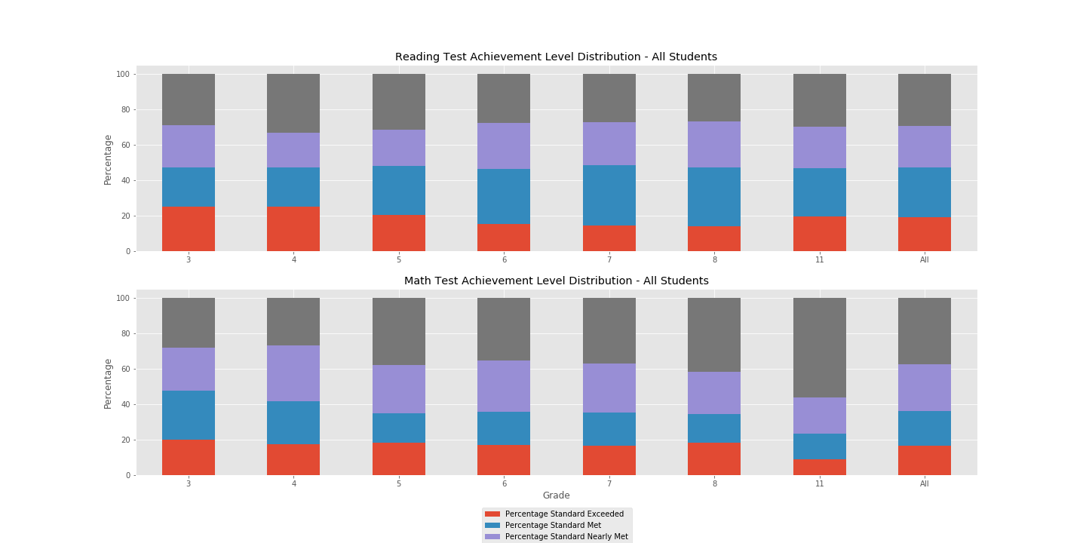
CAASP Test Scores for All Students

Slide 21
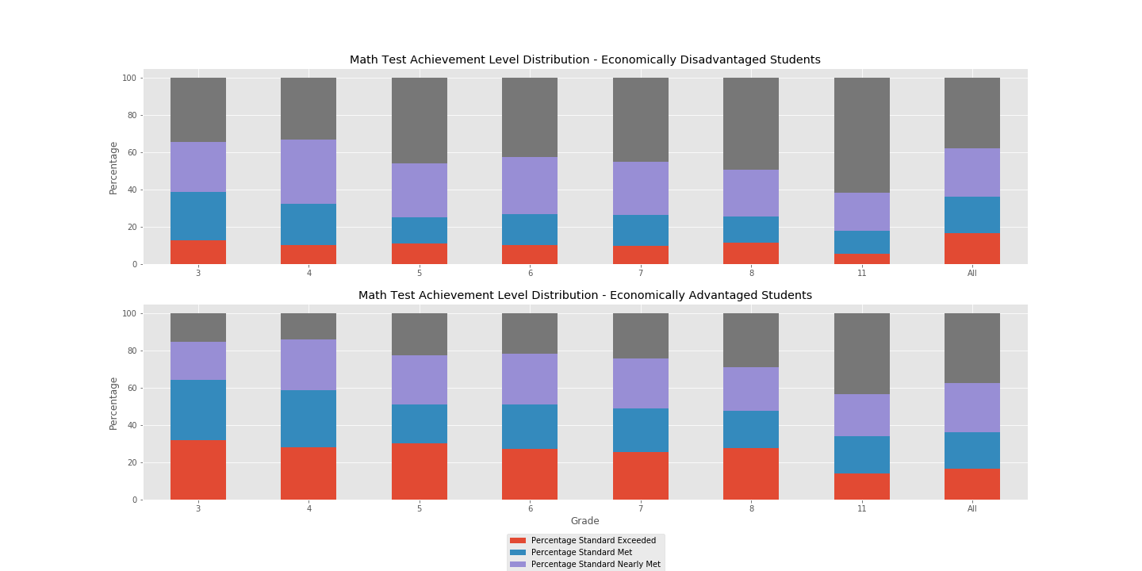
CAASP Math Test Scores for economically advantaged and disadvantaged students
Sunny

Slide 22
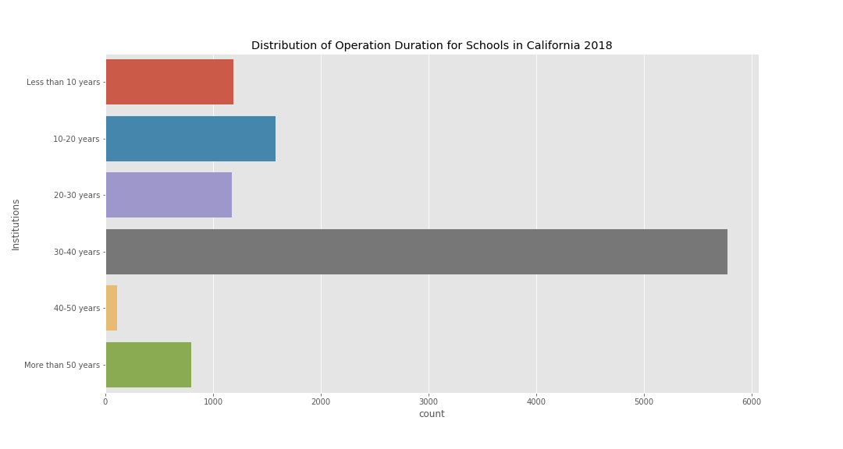
operation duration (years) for CA Schools

Slide 23
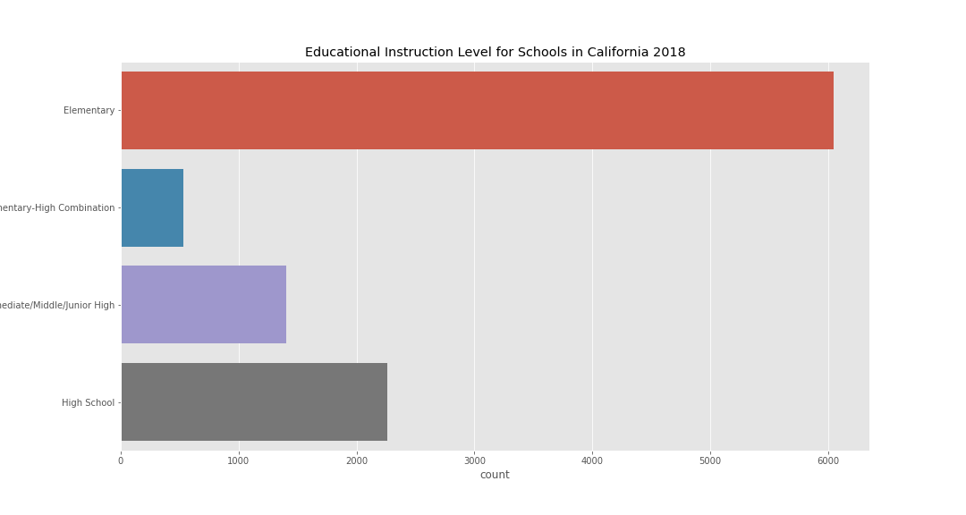
Distribution of School Type across CA

Slide 24
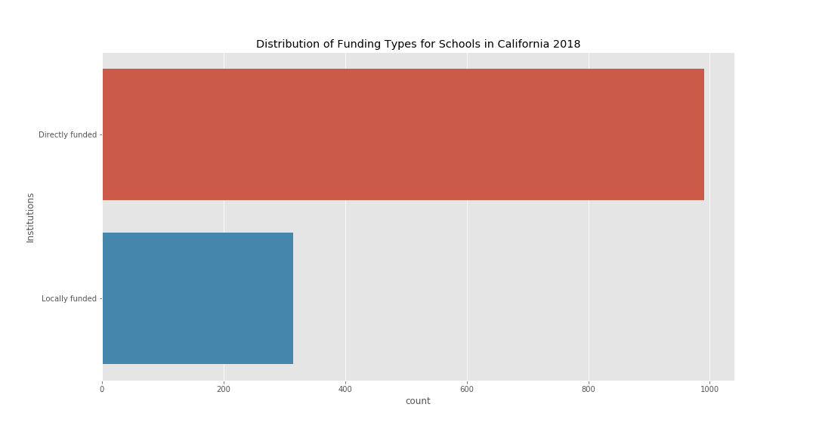
Funding Types for CA Schools

